Slide 1

Online Cook Book
INF 551 : Data Management Project
Anmol Chawla & Nikhit Mago

Slide 2



Slide 3
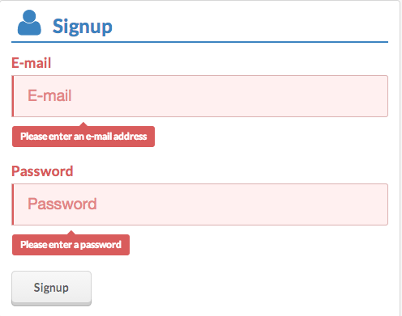




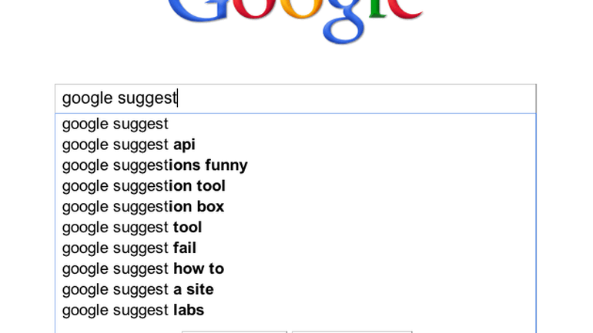

Feature List
User management system and authentication system
Key word search of recipe
Filter search results based on parameters (Faceted search)
View other associated data like ingredients, recipe etc. of a result
Ability to save a search query
Ability to execute a previous search history
Bonus Feature: Delete History

Slide 4






How did we execute it ?

Slide 5
Data Preprocessing
Data Size : 20,000+ recipes
Removing outliers and missing values
Removing special characters and stop-words
Hashing results of facets into buckets for Query Optimization
Creation of Inverted Index for all facets and keywords – Faster search
Uploading Data and Inverted Index to Google Firebase

Slide 6
Back-end Development
Javascript & JQuery
Querying Inverted Index: Each Facet and Keyword
Designed Combinatorial Algorithm: Displays the most appropriate results first

Slide 7
DEMONSTRATION

